Slide 1
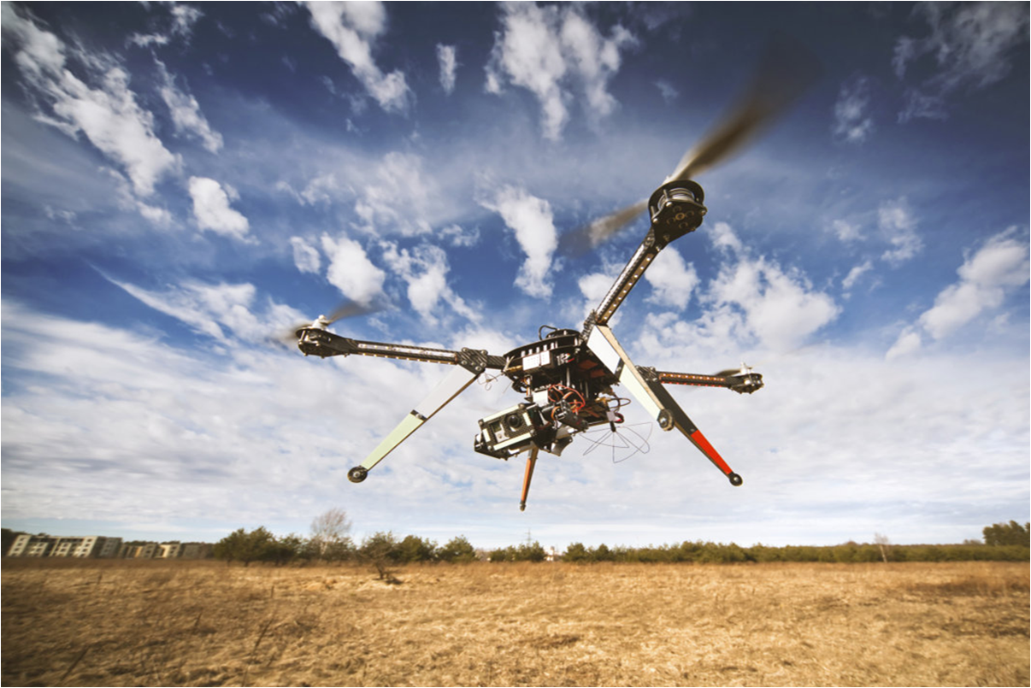



abcdef

Slide 2



Slide 4


Slide 5


Slide 8


Slide 12


Slide 13


Slide 14










